Slide 1
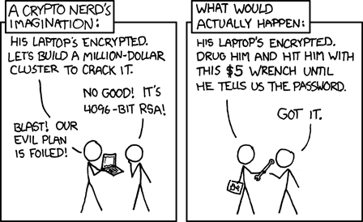
INFO215: Week 7b
Privacy & Social Information Systems, pt. 2
https://xkcd.com/538/

Slide 2
Privacy and Information Systems: Key Points from Last Week
What’s the definition of “privacy” (in the U.S.)?

Slide 3
Privacy and Information Systems: Key Points from Last Week
What’s the definition of “privacy” (in the U.S.)?
--------------
No exact definition exists.
Westin’s (1967) definition = privacy involves the ability to control the terms under which personal information is acquired and used
In social computing, “privacy” = control over the types of personal information made available online and control over who can access it
The 4th amendment has been applied, but no U.S. federal law specifically governs privacy.

Slide 4
Privacy and Information Systems: Key Points from Last Week
How are conceptions of privacy changing due to the burgeoning use of networked information systems?

Slide 5
Privacy and Information Systems: Key Points from Last Week
How are conceptions of privacy changing due to the burgeoning use of networked information systems?
----------------
Privacy used to be mostly connected to home. Now it refers to life inside the home, outside of home, and online as well.
Privacy used to be viewed largely as individual. Now it’s more of a community-based concept since we can all easily share each other’s personal information.

Slide 6
How do contextual factors affect people’s information sharing?
Lessig (1998) talks about four regulators of human behavior. How do each of these four factors regulate personal information people share online?
Market
Social Norms
Laws/Rules
Architecture/Code
Lessig, L. (1998). The new Chicago school. The Journal of Legal Studies, 27(S2), 661-691.

Slide 7
Privacy, Security, and Design
Web 2.0 and 3.0 support configurable privacy settings.
They let users choose the level of privacy settings they are comfortable with because privacy is not “one-size fits all.”
This increases the complexity of designing user-friendly privacy policies.
And, many – even most – users use default privacy and security settings. Why do you think this is so?

Slide 8

Biometrics and Privacy

Slide 9
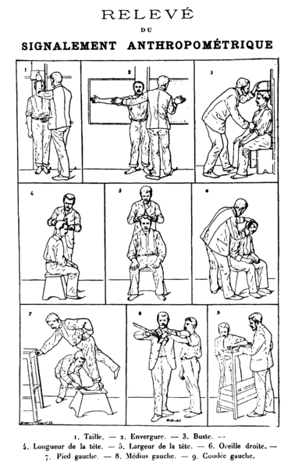
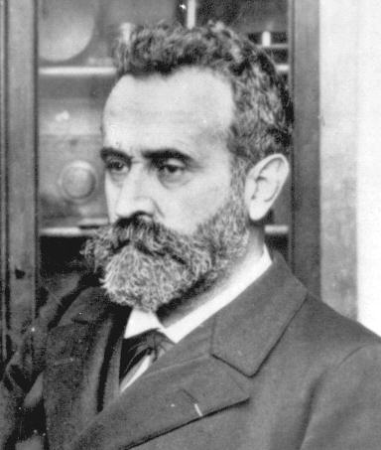
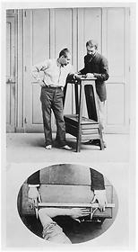
Biometrics
1870s - Alphonse Bertillon, anthropometrics
Identified individuals by body measurements

Slide 10
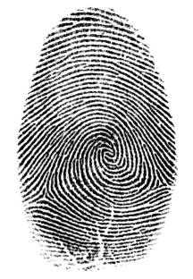
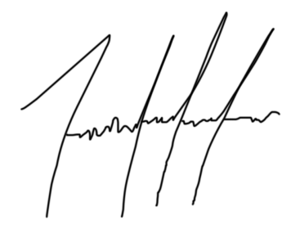
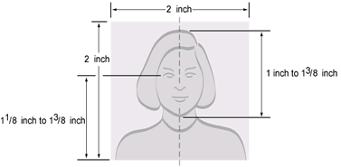
1890s – fingerprints
1960s – handwriting
1960s – facial recognition

Slide 11
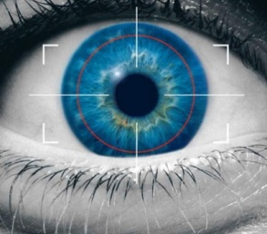
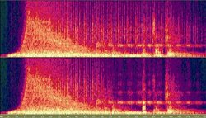
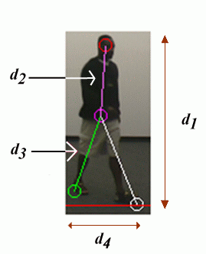
1980s – iris recognition
1980s – speech recognition
2000s – gait recognition

Slide 12

Illinois Biometric Information Privacy Act (BIPA)
Origins are largely grassroots:
“In 2007, a company that let customers pay in stores with their fingerprints went bust, and it discussed selling the fingerprint database. People who thought that was creepy wanted to stop such activities.” (Ovide, 2021)
Passed 2008. Still one of the toughest privacy laws in the U.S.
Only applies to Illinois residents
Limits what companies can do with biometric data collected from consumers, such as face scans, voice recognition, and fingerprints

Slide 13
Illinois Biometric Information Privacy Act (BIPA)
What does it do?
stipulates that companies can’t use consumers’ biometric data without their consent
Requires companies to limit the amount of biometric data that they collect
Gives individuals the right to sue companies over the use of their biometric data

Slide 14
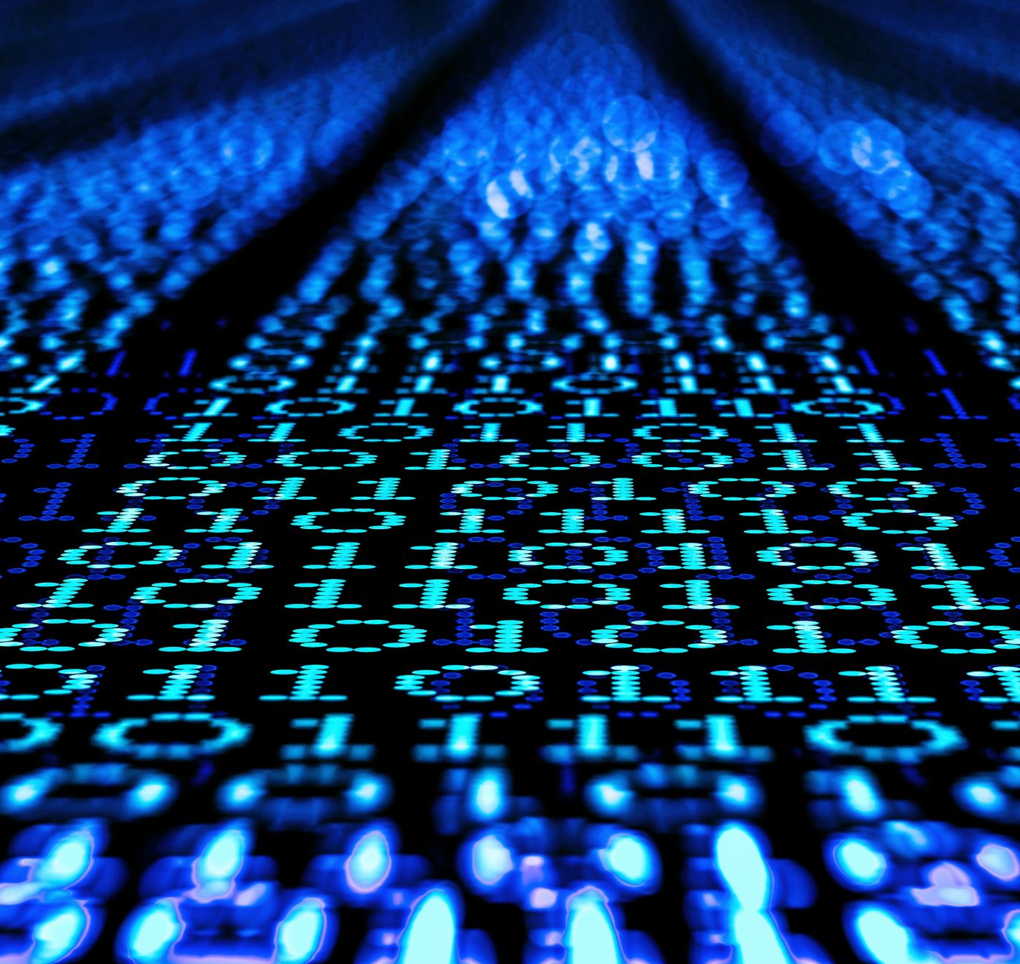
What’s coming next in biometric data collection?

Slide 15
Texas also has a weaker biometric data protection law filed a week ago– only allows the state attorney general to sue – Texas attorney general recently sued Meta (FB) under this law – results pending:
https://www.natlawreview.com/article/texas-ag-sues-meta-over-collection-and-use-biometric-data
Current bill in Maryland proposes a law similar to the Illinois Biometric Information Privacy Act
As of today, the IRS is allowing people to opt out of facial recognition to sign up for online accounts:
https://www.cnet.com/personal-finance/taxes/irs-adds-option-that-lets-taxpayers-skip-facial-recognition/

Slide 16
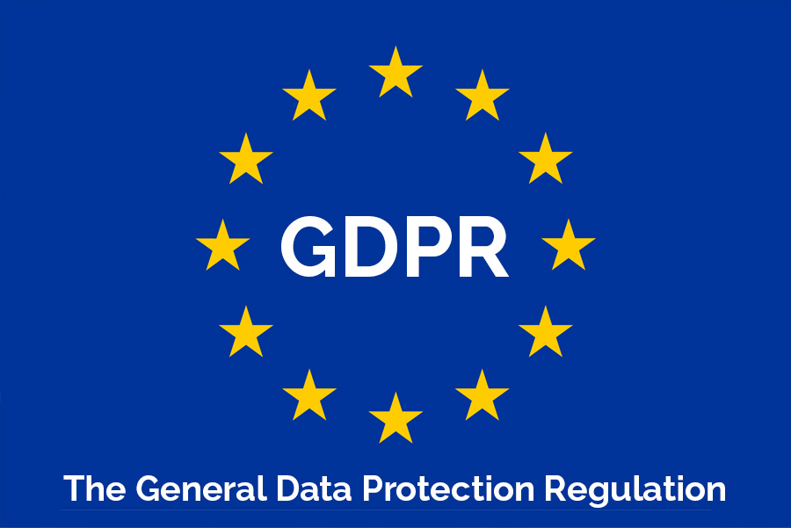
GDPR – What is it?

Slide 17
GDPR – "General Data Protection Regulation"*
European Union law instituted on May 25, 2018
Applies to all public and private EU companies and organizations that store personal data, and any outside organizations that conduct business with EU residents (Amazon, for example, or a nonprofit cancer research group).

Slide 18
GDPR – "General Data Protection Regulation"*
Core principles and requirements:
States that protection of personal data is a fundamental human right
Requires all organizations that collect and store user data to protect user data, give users access to their data, and to make it easily transferrable
Data processors (such as websites) must make their identity clear and ask users for consent before storing their data
Bans malicious activity, such as hacking and denial of service attacks
Requires security risk mitigation through methods such as encryption
Requires organizations to inform users within 72 hours of discovery of a data breach
Adapted from: https://techterms.com/definition/gdpr

Slide 19
GDPR breeches and fines between January 26, 2020, and January 27, 2021*:
GDPR fines rose by nearly 40% over the previous year
Penalties under the GDPR totaled €158.5 million ($191.5 million U.S.)
Data protection authorities recorded 121,165 data breach notifications (19% more than the previous 12-month period)
The biggest GDPR fine in this period = Google – €50 million ($56.6 million U.S.)
*Source = https://www.tessian.com/blog/biggest-gdpr-fines-2020/

Slide 20
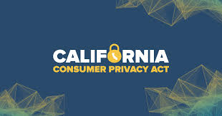
A Sea Change for Online Privacy in the U.S.? The California Consumer Privacy Act (CCPA)
State statute, effective January 1, 2020
It was partly modeled on the European Union's GDPR. GDPR is much broader and applies to many more companies.

Slide 21
The California Consumer Privacy Act (CCPA)
Applies to any corporation that:
Has annual gross revenues over $25 million;
Buys or sells the personal information of 50,000 or more consumers or households; or
Earns more than half of its annual revenue from selling consumers' personal information.

Slide 22
The California Consumer Privacy Act (CCPA)
Intended to provide California residents with the right to:
Know what personal data is being collected about them.
Know whether their personal data is sold or disclosed and to whom.
Say no to the sale of personal data.
Access their personal data.
Request a business to delete any personal information about a consumer collected from that consumer.
Not be discriminated against for exercising their privacy rights.

Slide 23
The California Consumer Privacy Act (CCPA)
Some large corporations are meeting its requirements for all users regardless of where they live (e.g. Microsoft); others are not (e.g. Facebook)
Estimated compliance expenditures in 2020 = $55 billion U.S.

Slide 24
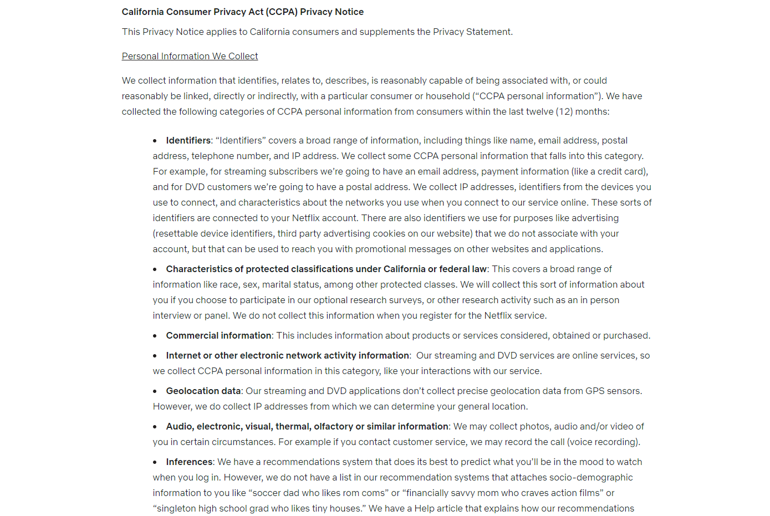
Netflix’s CCPA privacy notice (https://help.netflix.com/legal/privacy#ccpa)

Slide 25
California Consumer Privacy Act (CCPA) Discussion Questions: Jot down a few sentences about each question.
Would you want to request your personal data from companies using the CCPA? If yes, which companies, and what would your motivation for doing it?
Have you requested your personal in the past from a company, such as downloading your data from Twitter? If so, which company (ies), and what did you learn from the data they provided?
Do you think the CCPA will significantly impact how companies collect and store users’ personal data? Why or why not?
Do you think additional information privacy laws are needed? Why or why not?

Slide 26
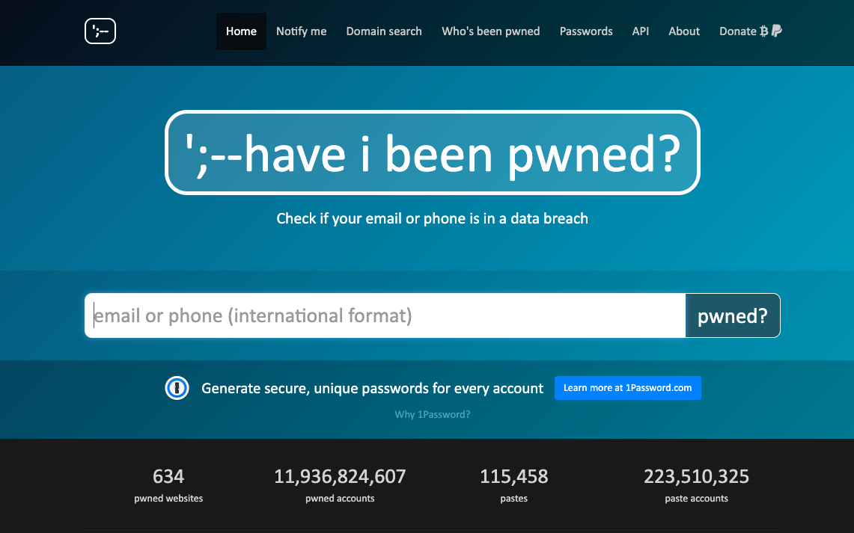
haveibeenpwned.com

Slide 27
Concluding Thoughts about Designing for Personal Data Privacy
Upon arriving at a site, users quickly have to decide (or at least they should be able to):
Who administers this site? Are they trustworthy?
What happens to my data?
Is the risk of sharing my personal data worth the benefits of using the site/services?
Privacy and trust are both user issues …
Site registration is often unpopular
… and usability issues
Site registration systems are often poorly designed
While there is no U.S. federal data privacy law, a growing number of states are considering statewide laws.

Slide 28
More Concluding Thoughts
The effects of the CCPA on user privacy protection are yet to be determined. Maybe it will lead to nation-wide privacy protection legislation?
Users’ willingness to share personal data varies along several lines:
Personal preferences -- some people like to share personal details; some people don’t
Personal demographic characteristics – age, family culture, ethnic background, religion, etc.
Geographic norms – local or national cultural norms, laws, etc.

